Slide 1
PRESENT SIMPLE
FORM

Slide 2
PRONOUNS USED WITH TODO
SINGULAR | PLURAL
I | we
you | you
he she it | they

Slide 3
PRONOUNS USED WITH TODO
SINGULAR | PLURAL
I | we
you | you
he she it | they
does | do

Slide 4
Form of present simple (Affirmative):
Subject +do , does + Verb (base) + Complement
Subject + Verb (base) + Complement
They go to London
He goes to London
e.g we say
I believe in God - not I am Believing in God

Slide 5
Form of present simple (Affirmative):
I work
You work
He works
She works
It works
We work
They work

Slide 6
Form of present simple (Affirmative):
More example:
I work in a bank.
You live near my brother.
I go to university every day.
I wake up 9 o'clock every day.
Water boils at 100 degrees Celsius.
He works in a restaurant.
She lives in Cardiff.
The train stops at Bristol.
We stop the lessons at 5.00 every day.

Slide 7
Negative:
We make simple present negative with
Subject+ do/does (not)+verb(base)+ complement.
I do not work.
You do not work.
He does not work.
she does not work.
It does not work.
We do not work.
They do not work.

Slide 8
Negative:
Example:
I do not know.
You do not think.
He does not like.
She does not remember.
It does not help.
We do not want.
They do not understand.

Slide 9
Form of present simple:
Contractions:
Contraction Pronunciation Meaning
don’t / / do not
doesn’t / / does not
Spelling:
Most s- forms are made by adding s to the simple form of the verb.
get: gets; live: lives
buy: buys; work: works
sit: sits; stay: stays

Slide 10
Form of present simple:
When the simple form ends in y preceded by a consonant, the y is changed to i and es is added.
study: studies
hurry: hurries
dry: dries
cry: cries
reply: replies

Slide 11
Form of present simple:
When the simple form ends in a letter (sh,ch,x) or combination of letters (s,z),then es is added to the simple form.
miss: misses
push: pushes
wash: washes
watch: watches
fix: fixes
teach: teaches
buzz: buzzes
pass: passes
mix: mixes

Slide 12
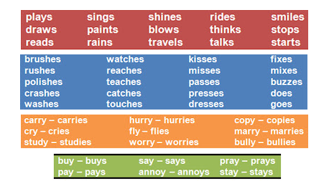
Form of present simple:

Slide 13
Question:
Does + Subject + Verb (base) + Complement + ?
Do
Does he go to London ?
Do they go to London ?
It is used to ask simple questions

Slide 14
Question:
Do you play the piano?
Does Jack play football?
Do Rita and Angela live in Manchester?
Do you drink mineral water?
Do Sarah and Linda feed their pets?
Does your teacher check your homework?
Do they live in the old house?

Slide 15
Passive:
Object + is + Verb(p.p)
are
He cleans the window (present simple)
The window is cleaned (Passive)
Note:
Not all verbs in English are take an object, therefore, some sentences are complete without an object.
Example:
John lives far away.

Slide 16
Passive:
1) Mr Jones watches films. Films are watched. | 6) I take photos. Photos are taken.
2) The people speak English. English is spoken. | 7) She does the housework. The housework is done.
3) He reads comics. Comics are read. | 8) The policemen help the children. The children are helped.
4) We play volleyball. Volleyball is played. | 9) He writes text messages. Text messages are written.
5) They sing the song. The song is sung. | 10) Mother waters the flowers. The flowers are watered.

Slide 17
